Slide 1
EMBEDDED SYSTEM

Slide 2
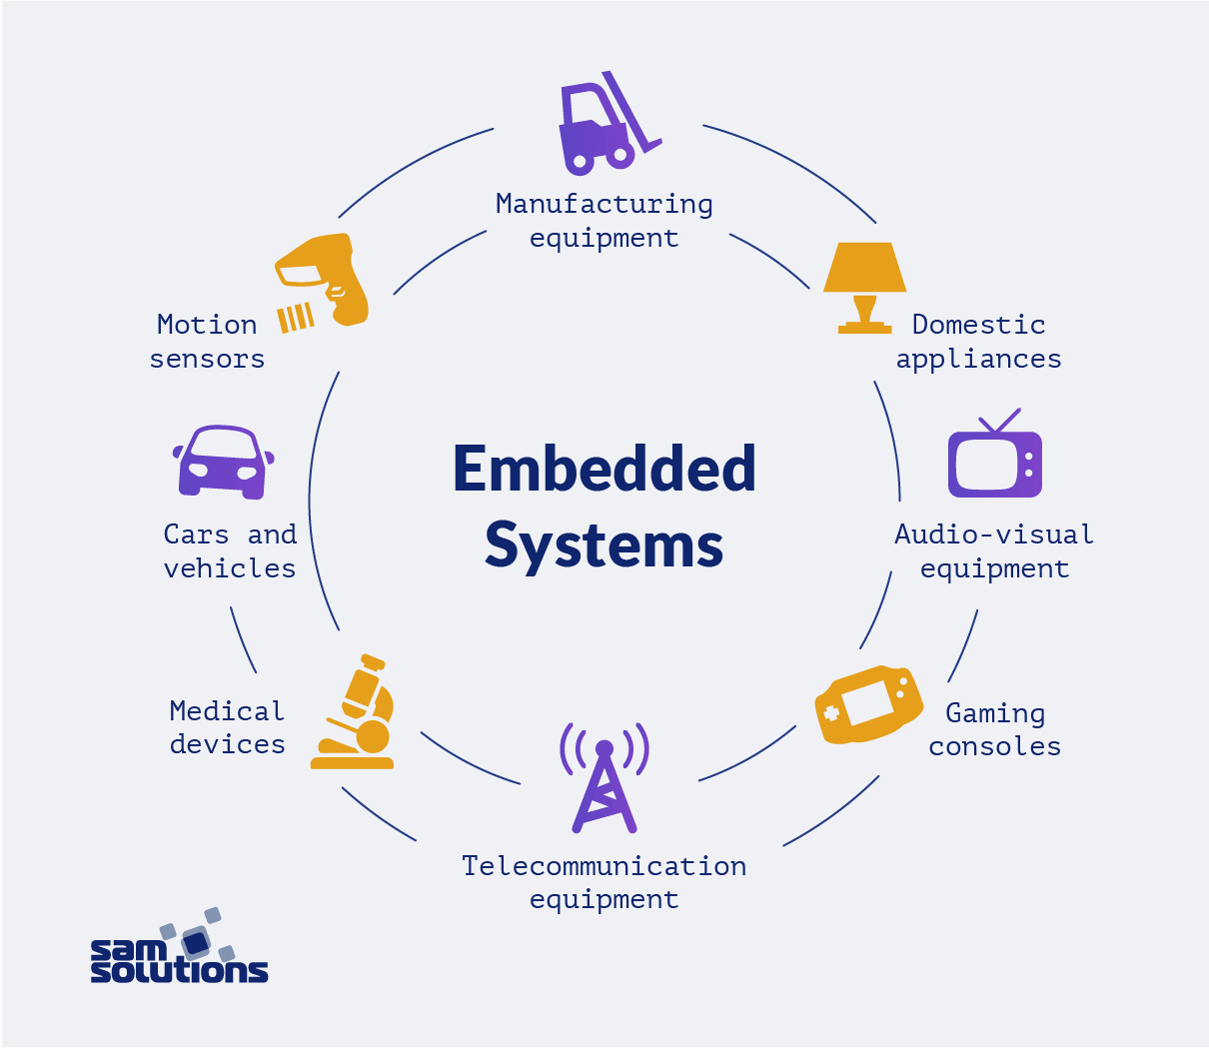
WHAT IS AN EMBEDDED SYSTEM:
As its name suggests, Embedded means something that is attached to another thing. An embedded system can be thought of as a computer hardware system having software embedded in it.
An embedded system can be an independent system or it can be a part of a large system.
An embedded system is a microcontroller or microprocessor based system which is designed to perform a specific task.

Slide 3
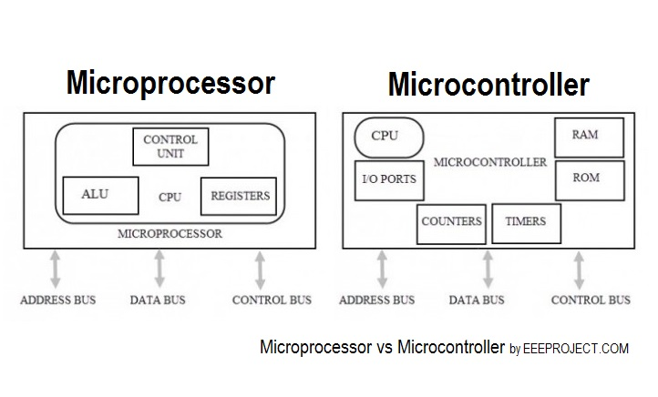
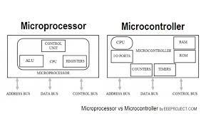

Slide 4
Types of Microcontrollers:
Microcontrollers are divided into various categories based on memory, architecture, bits and instruction sets. Following is the list of their types −
Bit:
Based on bit configuration, the microcontroller is further divided into three categories.
8-bit microcontroller − This type of microcontroller is used to execute arithmetic and logical operations like addition, subtraction, multiplication division, etc. For example, Intel 8031 and 8051 are 8 bits microcontroller.

Slide 5
16-bit microcontroller − This type of microcontroller is used to perform arithmetic and logical operations where higher accuracy and performance is required. For example, Intel 8096 is a 16-bit microcontroller.
32-bit microcontroller − This type of microcontroller is generally used in automatically controlled appliances like automatic operational machines, medical appliances, etc.

Slide 6
Applications of Embedded System:
Automotive Vehicles
Phones
Medical Equipment
Industrial Machines
Security Systems
Military Equipment

Slide 7
PIC18f4580 Microcontroller

Slide 8
PIC Introduction:
Microchip was invented the PIC in 1993.
PIC Microcontroller is based Harvard Architecture.
PIC Microcontroller are available are wide between 8 bit to 32 bits.

Slide 9
PIC Family:
PIC Microcontrollers from Microchip Company are divided into 5 large families. Each family has a variety of components that provide built-in special features:
The first family, PIC10 (10FXXX) - is called Low End.
The second family, PIC12 (PIC12FXXX) – is called Mid-Range.
The third family is PIC16 (16FXXX).
The fourth family is PIC 17/18(18FXXX)
The fivth family is PIC32 (32FXXX)

Slide 10
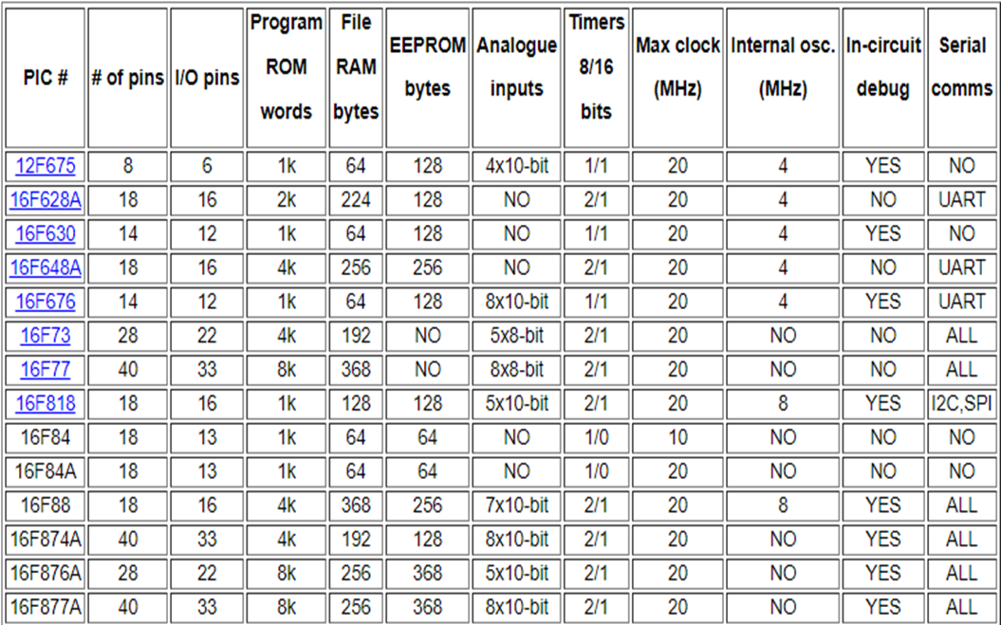

Slide 11
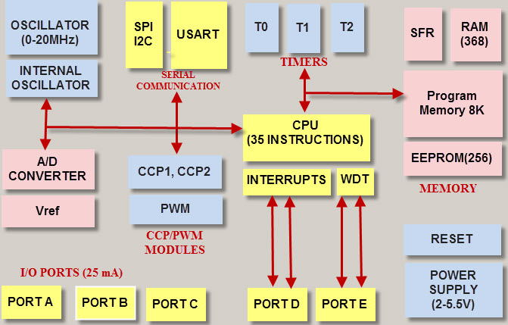
PIC18f4580 Block Diagram:

Slide 12
ALU(Arithmetic Logic Unit):
ALU perform arithmetic and logic operation.
ALU also manipulate the data.
Individual bit of register can be set, reset, cleared, complemented, used in logical computation.

Slide 13
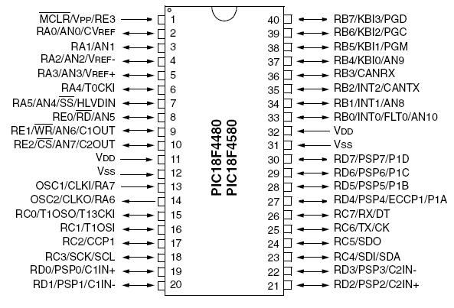
Pin Diagram

Slide 14
PIC18f Features:
40 Pins low Power uc.
Flash Program memory: 32Kb .
EEPROM Data Memory: 256 bytes.
SRAM Data Memory: 1536 bytes.
Input & Output pins : 33.
Timers: One 8 bit / Three 16 bit.
A/D Converter : 10 bit Eleven Channels.
CAN: CAN 2.0B Specification with transmit & Receive Buffers.
PWM: 10-bit two modules.
MSSP: SPI & I2C Master & Slave support.
Enhanced USART: Addressable with RS-485,RS232 & LIN Support.
External Oscillator.: upto 40MHz.
Internal Oscillator: 4MHz.

Slide 15
HOW TO PROGRAM THE INPUT AND OUTPUT PORTS
As we have studied 5 input and output ports namely PORTA, PORTB, PORTC, PORT D and PORT E which can be digital as well as analog.
We will configure them according to our requirements. But in case of analog mode, the pins or the ports can only act as inputs. There is a built in A to D converter which is used in such cases. Multiplexer circuits are also used.
But in digital mode, there is no restriction. We can configure the ports as output or as input. This is done through programming. For PIC the preferable compiler is mikroC pro which can be downloaded from their website.
There is a register named as ‘TRIS’ which controls the direction of ports. For different ports there are different registers such as TRISA, TRISB etc.
If we set a bit of the TRIS register to 0, the corresponding port bit will act as the digital output.
If we set a bit of the TRIS register to 1, the corresponding port bit will act as the digital input.
For example to set the whole portb to output we can write the program statement as:
TRISB=0;

Slide 16
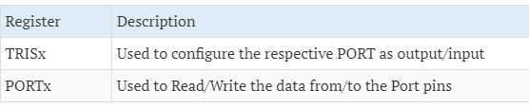
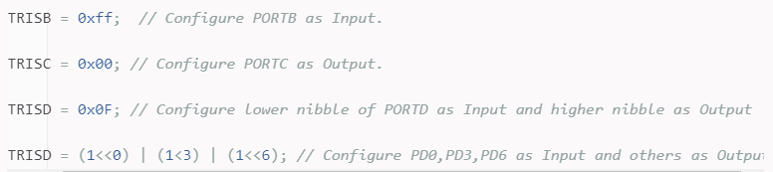

Slide 17
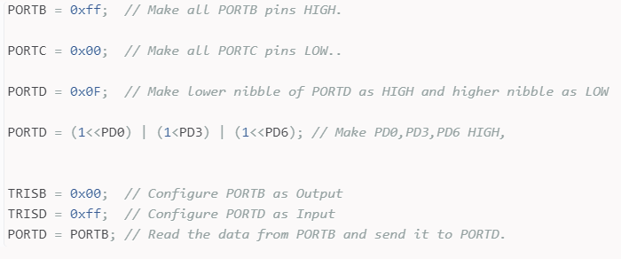
PORTx:
This register is used to read/write the data from/to port pins. Writing 1's to PORTx will make the corresponding PORTx pins as HIGH. Similarly writing 0's to PORTx will make the corresponding PORTx pins as LOW.
Before reading/writing the data, the port pins should be configured as Input Output.

Slide 18
Now the port will act as the output port and we can send any value on the output such as
PORTB=0XFF;
FF represents all 1’s in binary i.e. FF=11111111, now all the pins of port b are high. If we connect LEDs at all the pins then they will all start glowing in this condition.
If we want to negate the values of the port b we can use the statement:
PORTB=~PORTB;
Now all the pins of the port b will be low.

Slide 19
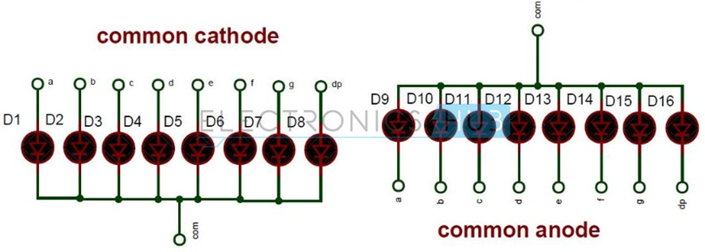
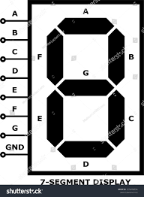
PIC Interfacing with Seven Segment:
Seven segment displays are used to indicate numerical information.
Seven segments display can display digits from 0 to 9 and even we can display few characters like A, b, C, H, E, e, F, etc.
Seven segment displays internally consist of 8 LEDs. In these LEDs, 7 LEDs are used to indicate the digits 0 to 9 and single LED is used for indicating decimal point.
Generally, seven segments are two types, one is common cathode and the other is common anode.

Slide 20
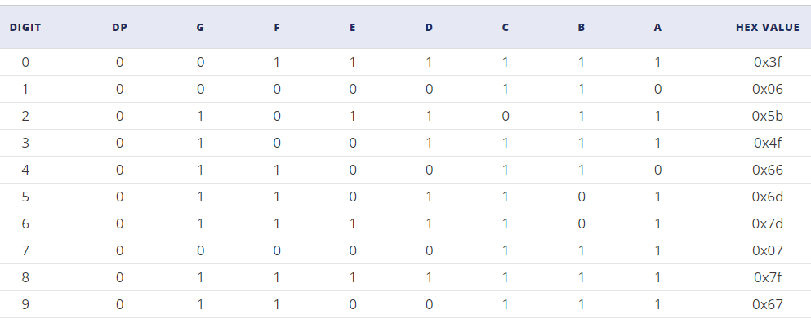

Slide 21
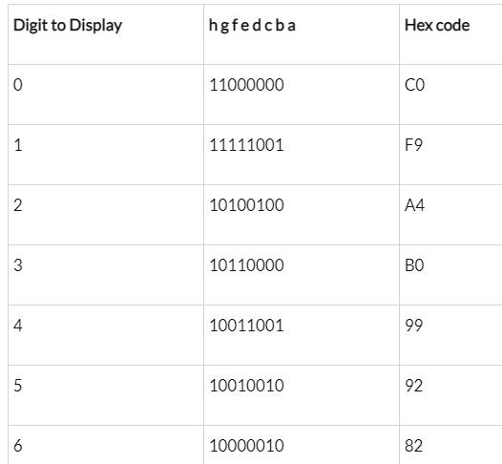
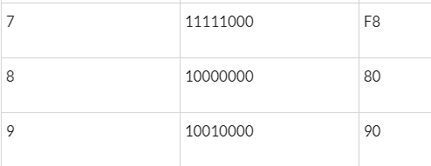

Slide 22
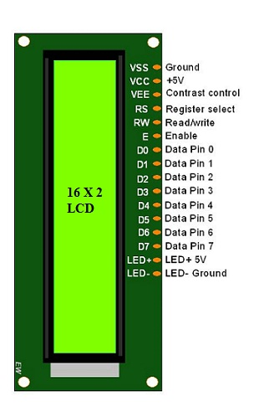

Slide 23
Interfacing 16×2 LCD with 8051
16×2 Liquid Crystal Display which will display the 32 characters at a time in two rows (16 characters in one row). Each character in the display is of size 5×7-pixel matrix.
Simple steps for displaying a character or data
E=1; enable pin should be high
RS=1; Register select should be high
R/W=0; Read/Write pin should be low.
Send a command to the LCD just follows these steps.
E=1; enable pin should be high
RS=0; Register select should be low
R/W=0; Read/Write pin should be low.

Slide 24
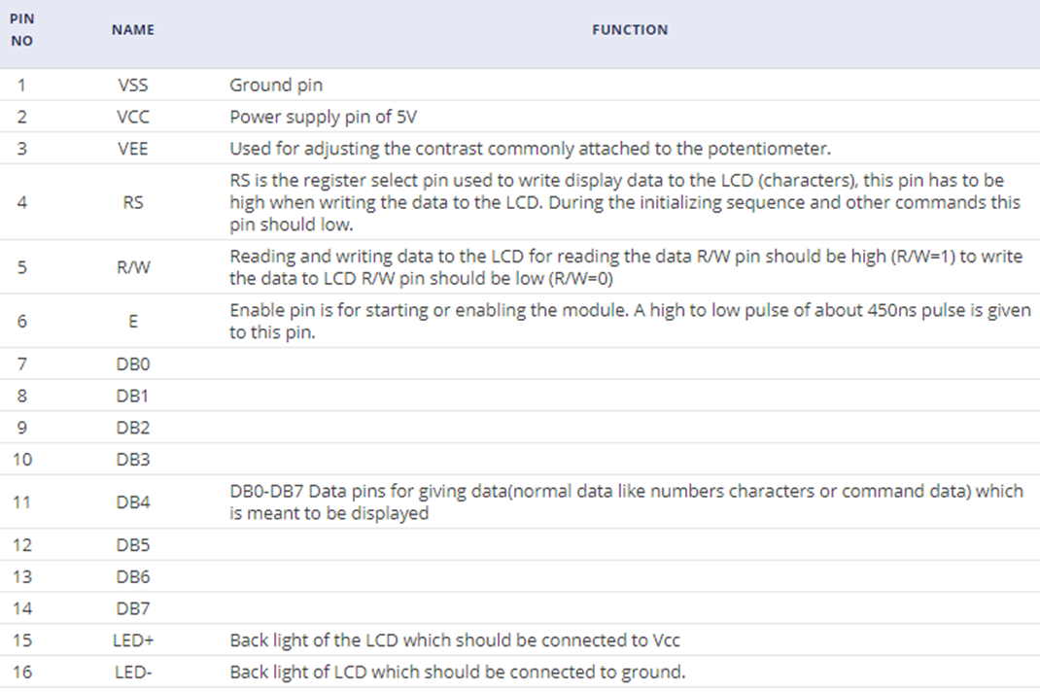

Slide 25
For displaying a character, you should enable the enable pin (pin 6) by giving a pulse of 450ns, after enabling the pin6 you should select the register select pin (pin4) in write mode. To select the register, select pin in write mode you have to make this pin high (RS=1), after selecting the register select you have to configure the R/W to write mode that is R/W should be low (R/W=0).
Simple steps for displaying a character or data:
E=1; enable pin should be high
RS=1; Register select should be high
R/W=0; Read/Write pin should be low.
Send a command to the LCD just follows these steps:
E=1; enable pin should be high
RS=0; Register select should be low
R/W=0; Read/Write pin should be low.

Slide 26
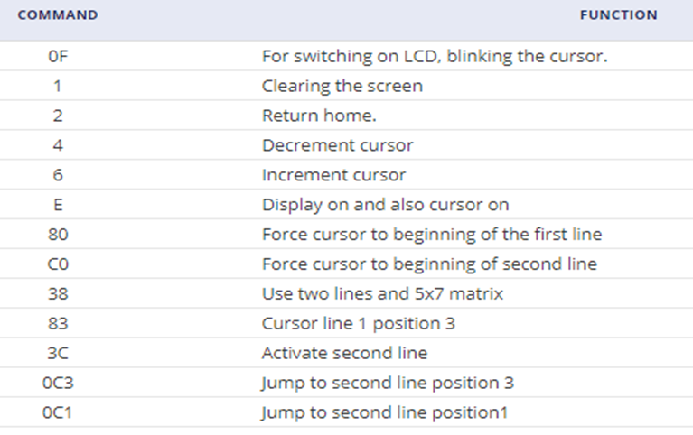
Commands List

Slide 27
DC Motor Interfacing with PIC:
A DC motor in simple words is a device that converts electrical energy (direct current system) into mechanical energy. It is of vital importance for the industry today.
The maximum output current of the microcontroller pin is 15mA at 0 to 5V. But the power requirements of most DC motors are out of reach of the microcontroller and even the back emf (electromotive force) which is produced by the motor may damage the microcontroller. Hence it is not good to interface the DC motor directly to the controller. So use a motor driver circuit in between of DC motor and controller.

Slide 28
Here, we are using an L293D motor driver IC to drive DC motors. Using this IC, we can drive 2 DC motors at a time. For this IC motor supply is variable 4.5 to 36V and it provides a maximum current of 600mA.
The maximum current capacity of L293 is 600mA/channel. So do not use a motor that consumes more than that.
The supply voltage range of L293 is between 4.5 and 36V DC. So you can use a motor falling in that range.
Mostly in Robotic application, we will use DC gear Motor. So the same logic is used for that Gear motor also.

Slide 29
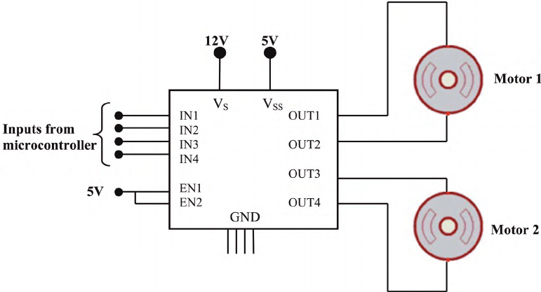
DC Motor Driver:

Slide 30
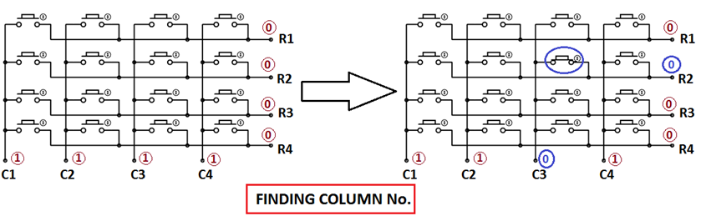
4x4 Keypad interfacing with PIC:
For finding Column number:
When a switch/key is pressed, the corresponding row and column will get short.
Output of the corresponding column goes to go low.
Since we have made all the rows zero so this gives the column number of the pressed key.

Slide 31
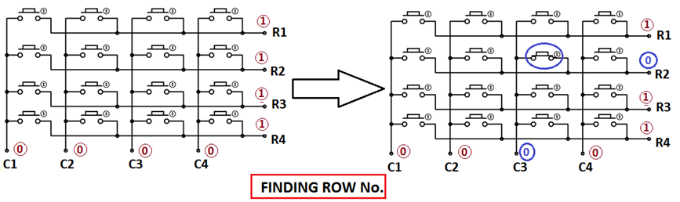
For Finding Row number:
After the detection of column number, the controller set’s all the rows to high.
Each row is one by one set to high by the microcontroller and the earlier detected column is checked and obviously it becomes zero.
The row due to which the column gets zero is the row number of the pressed key.

Slide 32
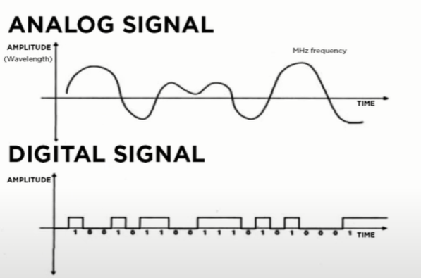
Sensor Classification:

Slide 33
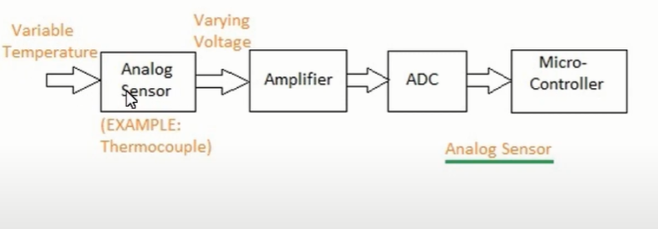
Analog to Digital Conversion Process:

Slide 34
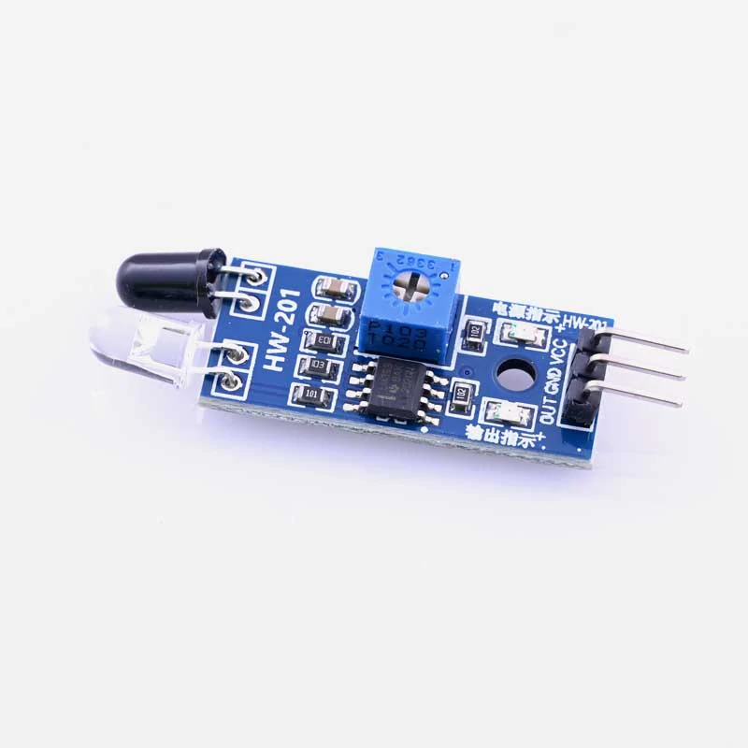
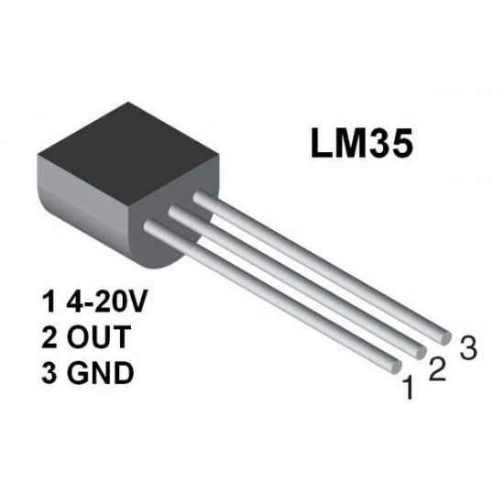
Digital Sensor Analog Sensor

Slide 35
Resolution:
Resolution refers to the conversion of an analog voltage to a digital value. It indicates the number of discrete values that an ADC can produce over the range of analog values. The values are usually stored electronically in binary form, so the resolution is usually expressed in bits.

Slide 36
Resolution:
10 Bit ADC
10 Bit = 2^10
10 bit = 0 to 1023.

Slide 37
Step Size:
It is the voltage difference between one digital level and the next level that can be measured by ADC. In a 4-bit converter, an input of 1 Volt produce an output of 0001, then the step size is 1 Volt. 0 volts is always considered 0000. Distortion in the signal can be reduced by decreasing the step size to 0.5 volts but it lowers the maximum input reading. Ife we are using smaller step size, higher bit converter is needed to have maximum voltage.
It has 10 bit resolution. Other ADC can have n bit resolution and n can be 8,10,12,16 or 24 bits. If ADC has higher resolution, it gives smaller step size.If ADC has 8 bit resolution, input voltage span is 0-5V and the step size is 19.53mV (5V/1023).

Slide 38
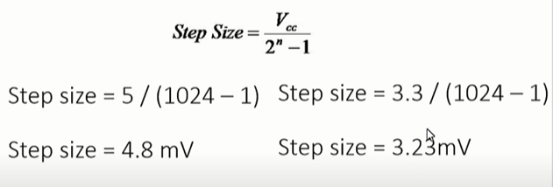

Slide 39
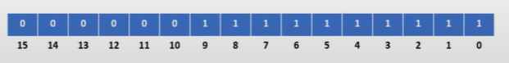
ADC Value:
ADC value is 10 Bit Value
So the max. Value is 1023
And the min. Value is 0
Let's assume the
Value is 1023
1023 in binary represented as,

Slide 40
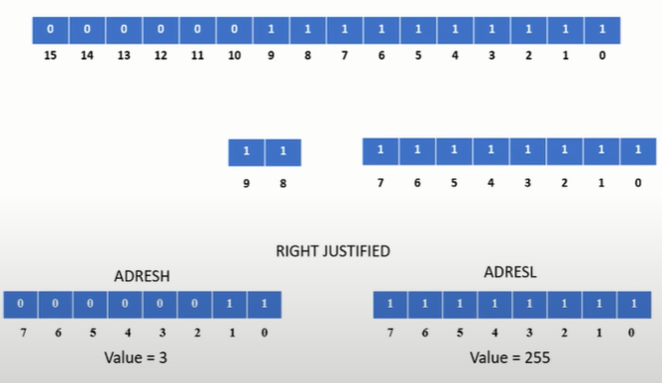

Slide 41
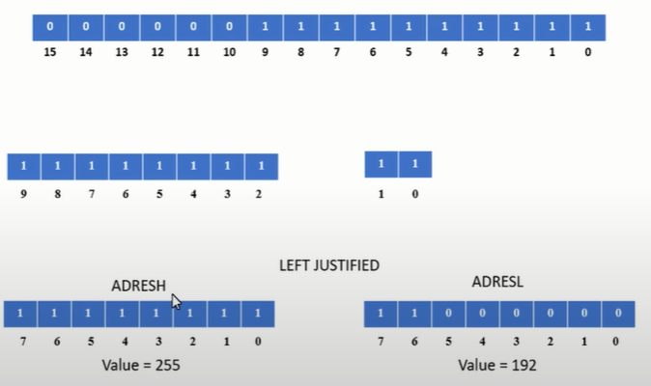

Slide 42
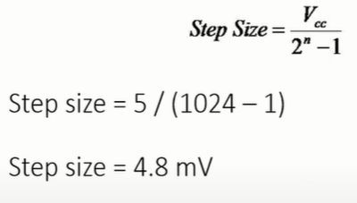
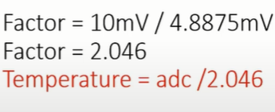
Step Size:

Slide 43
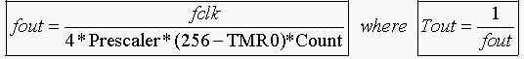
TIMER 0:
Ftimer = Fosc / Machine cycle
= 4 MHz / 4
= 1 MHz
Prescaler = Its Frequency divider.
F = 1MHz / 256
= 0.0039MHz
Ttimer = 1 / 0.0039MHz = 256.41 us.
Delay = Max. Count - Desired value / Ttimer
= 65535 - 20 ms / 256us
= 65535 - 20 X 10^(-3) / 256 X 10 (-6)
= 65535 - 0.0781 X 10^3
= 65535 - 78.12
Delay = 65456
Now, Convert Decimal into Hexa-decimal
Delay = FFB0.
TMR0H=0xFF
TMR0L=0xB0.

Slide 44
Programming steps for delay function:
Load TXCON register value i.e.T0CON
Load calculated TMRxH value i.e. here TMR0H = 0x
Load calculated TMRxL value i.e. here TMR0L = 0x.
Start the timer by setting a TRx bit. i.e. here TMR0ON = 1.
Poll TMR1IF flag till it does not get set.
Stop the timer by clearing TMRxON bit. i.e. here TMR0ON = 0.
Clear timer flag TMRxIF bit i.e. here TMR0IF = 0.
Repeat from step 2 to 7 for the delay again.

Slide 45
TIMER 1:
Delay = Max. Count - Desired value / Ttimer
= 65535 - 50 ms / 8 us
= 65535 - 50 X 10^(-3) / 8 X 10 (-6)
= 65535 - 6.25 X 10^3
= 65535 - 6250
Delay = 59285
Now, Convert Decimal into Hexadecimal
Delay = E795.
TMR0H=0xE7
TMR0L=0x95.
Ftimer = Fosc / Machine cycle
= 4 MHz / 4
= 1 MHz
Prescaler = Its Frequency divider.
F = 1 MHz / 8
= 0.125MHz
Ttimer = 1 / 0.125 MHz = 8 us.

Slide 46
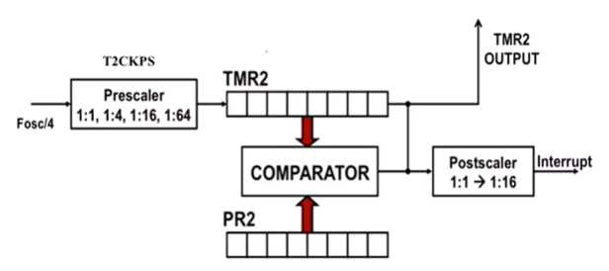
TIMER 2 Diagram:

Slide 47
TIMER 2:
The TMR2 and PR2 compare its value. TMR2 has 00h but its increment by 1 per clock cycle, PR2 has 20h.
>> Max. value should not be greater than 255.
Ftimer = Fosc / Machine cycle
= 4 MHz / 4
= 1 MHz
Prescaler = Its Frequency divider. (16)
F = 1 MHz / 16
= 0.0625MHz
>> Now, select the postscaler (1)
F= 0.0625 / 1
= 0.0625
T timer = 1 / F
= 1 / 0.0625
= 16 us.
Delay = Desired time / Ttimer
= 5ms / 16 us.
= 0.3125
=312.5
255 < 312

Slide 48
INTERRUPT
An interrupt is an event that occurs randomly in the flow of continuity. It is just like a call you have when you are busy with some work and depending upon call priority you decide whether to attend or neglect it.

Slide 49
What is a PWM Signal?
Pulse Width Modulation (PWM) is a digital signal which is most commonly used in control circuitry. This signal is set high (5v) and low (0v) in a predefined time and speed. The time during which the signal stays high is called the “on time” and the time during which the signal stays low is called the “off time”.

Slide 50
PWM using PIC18f:
PWM signals can be generated in our PIC Microcontroller by using the CCP (Compare Capture PWM) module. The resolution of our PWM signal is 10-bit, that is for a value of 0 there will be a duty cycle of 0% and for a value of 1024 (2^10) there be a duty cycle of 100%. There are two CCP modules in our PIC MCU (CCP1 And CCP2), this means we can generate two PWM signals on two different pins.

Slide 51
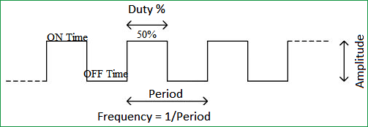
Duty cycle of the PWM:
The percentage of time in which the PWM signal remains HIGH (on time) is called as duty cycle. If the signal is always ON it is in 100% duty cycle and if it is always off it is 0% duty cycle.
Duty Cycle =Turn ON time/ (Turn ON time + Turn OFF time)

Slide 52
PIC uses TIMER2 for generating the PWM signals. Let's relate the above concepts with the PIC registers.
Period:PR2 register is used to specify the PWM Period. The PWM period can be calculated using the following.
formula. PWM Period = [(PR2) + 1] * 4 * TOSC * (TMR2 Prescale Value)
Ton: Time for which the signal is ON/HIGH. Toff: Time for which the signal is OFF/LOW. Period: The cycle time of the signal which is nothing but the sum of Ton and Toff period.
Period= Ton+Toff Freq of Pwm signal = 1/Period.

Slide 53
we have to set the Frequency of the PWM signal. The value of the frequency has to be written to the PR2 register. The desired frequency can be set by using the below formulae.
PWM Period = [(PR2) + 1] * 4 * TOSC * (TMR2 Prescale Value)
Rearranging these formulae to get PR2 will give
PR2 = (Period / (4 * Tosc * TMR2 Prescale )) - 1
We know that Period = (1/PWM_freq) and Tosc = (1/_XTAL_FREQ). Therefore.....
PR2 = (_XTAL_FREQ/ (PWM_freq*4*TMR2 PRESCALE)) – 1;

Slide 54
PR2 = (_XTAL_FREQ/ (PWM_freq*4*TMR2 PRESCALE)) – 1;
= 4 MHz / 5 KHz * 4 *16
=12-1
=11
Duty cycle means On-Time of the Total time (pulse)
when TMR2 and Duty cycle(CCPR1L) is matched then pulse go to Low
when TMR2 and PR2 is matched then pulse go to High.

Slide 55
Duty cycle means On-Time of the Total time (pulse).
For 50% of Duty Cycle
Duty cycle= 11 x 50 / 100
= 11 x 0.5
= 5.5
= 5
For 10% Duty Cycle :
Duty cycle= 11 x 10 / 100
= 11x 0.1
= 1.1
= 1

Slide 56
DCB1 and DCB0 for decimal point fraction of Duty Cycle
0 0 0
0 1 0.25
1 0 0.50
1 1 0.75
CCPR1L: This Register is used to store the integer part of Duty cycle.
Example:
If Ans is 10.0 we mention then

Slide 57
Steps to Configure PWM:
Configure the CCP1 module for PWM operation.
Set the PWM period by writing to the PR2 register.
Set the PWM duty cycle by writing to the CCPR1L register and CCP1CON<5:4> bits.
Make the CCP1 pin an output by clearing the TRISC<2> bit.
Set the TMR2 prescale value and enable Timer2 by writing to T2CON.
Start the Timer.

Slide 58
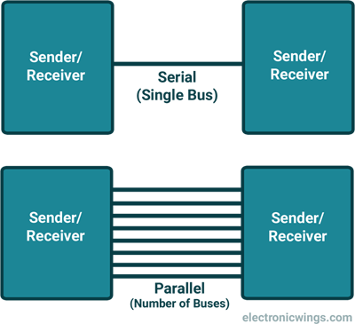
UART(Universal Asynchronous Reception Transmit):

Slide 59
There are Two methods of serial communication:
Synchronous Communication: Transfer of bulk data in the framed structure at a time
Asynchronous Communication: Transfer of a byte data in the framed structure at a time
8051 has built-in UART with RXD (serial data receive pin) and TXD (serial data transmit pin).

Slide 60
Asynchronous communication:
Asynchronous serial communication is widely used for byte-oriented transmission.
Frame structure in Asynchronous communication:
START bit: It is a bit with which serial communication starts and it is always low.
Data bits packet: Data bits can be 5 to 9 bits packet. Normally we use 8 data bit packet, which is always sent after the START bit.
STOP bit: This is one or two bits. It is sent after the data bits packet to indicate the end of the frame. The stop bit is always logic high.
In an asynchronous serial communication frame, the first START bit followed by the data byte and at last STOP bit forms a 10-bit frame. Sometimes the last bit is also used as a parity bit.

Slide 61
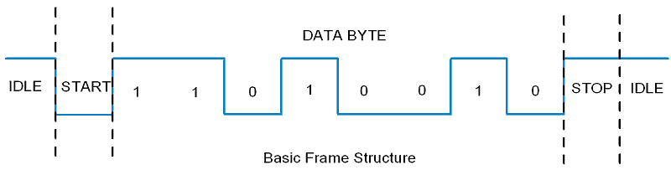

Slide 62
UART:
When BRGH=1 (HighSpeed) the formula will be : Fosc / 16(n+1)
When BRGH=0 (Low Speed) the formula will be : Fosc / 64(n+1)

Slide 63
UART:
n= value of SPBRG
B.R = Fosc / 16 (n+1)
= 4 MHz / 16 (n+1)
9600 = 4 MHz / 16(n+1)
16(n+1) = 4 MHz / 9600
N+1 = [ (4 x 10^6) / (16 x 9600)] - 1
N = [1000 / 384] - 1
= 26.89-1
N = 25

